Slide 1

Minnesota Metro Traffic Interstate
BI Specialist
Joao Ornelas

Slide 2


Agenda
Project Overview
Data and Analysis
Recommendations
Q&As

Slide 3
Executive summary
The Minnesota Department of Transportation engaged our team to design a traffic analytics dashboard that reveals when and under what conditions road usage is highest. Using traffic volume, date/time, weather, and holiday data (plus a custom holiday flag), we built three core views:
Time-based trends:
A multi-year monthly line chart and hourly heat map pinpoint peak seasons, days, and rush-hour periods.
Weather impact:
A bar chart shows traffic is highest on clear/cloudy days and drops significantly during rain and other adverse conditions.
Holiday surges:
A holiday comparison chart highlights Labor Day and New Year’s Day as the heaviest-traffic holidays, with several other national holidays also showing substantial increases.

Slide 4

Project Overview
The purpose of this dashboard is to give the Minnesota Department of Transportation clear, data-driven insight into when and under what conditions traffic is heaviest, by time of year, weather, and holidays, so they can better plan maintenance, staffing, and traffic management to improve safety and reduce congestion

Slide 5
Project Overview
Goals And Expectations
The MnDOT expects a dashboard that it’s clear, easy-to-use for monitoring traffic patterns.
Its expected to provide insights on 3 aspects:
Traffic periods by year, month, week, day, and hour
Traffic Volume on different weather conditions.
Holidays with highest traffic surges

Slide 6

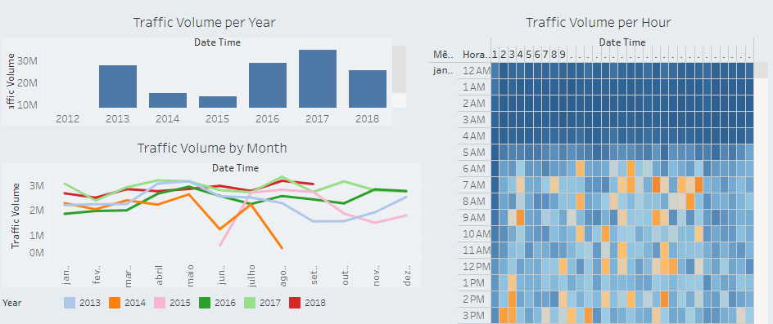
Data Visuals Overview
Summary of Insights
Traffic Volume per year, month hour

Slide 7
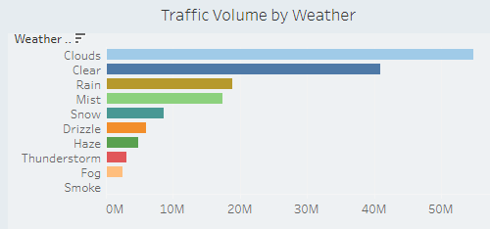
Data Visuals
Summary of Insights
Traffic Volume by weather conditions

Slide 8
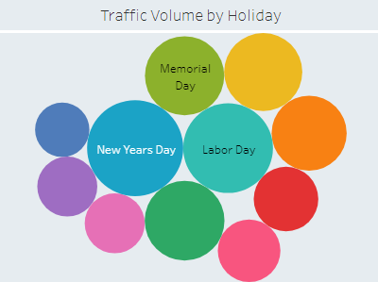
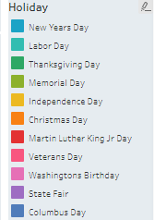

Data Visuals
Summary of Insights
Traffic Volume per holiday

Slide 9
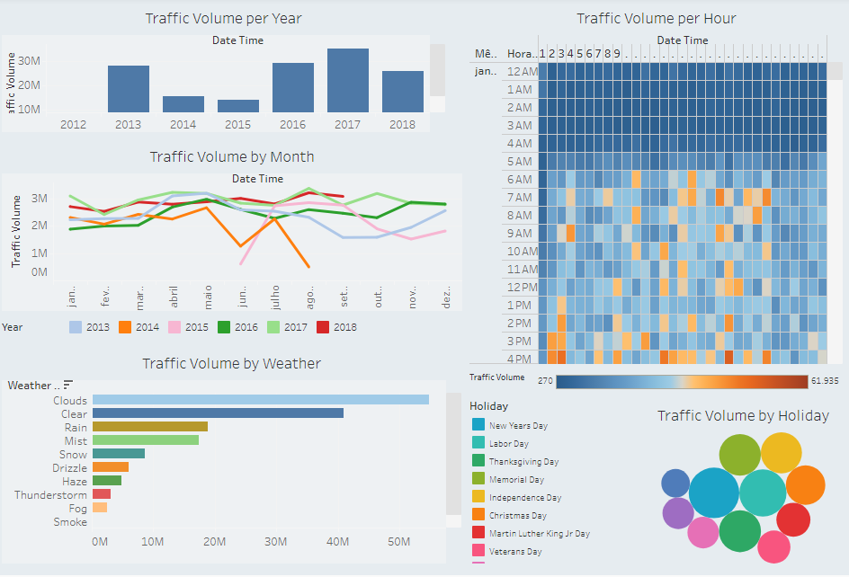
Dashboard Visuals Overview
Final Mock-up Tableau Link

Slide 10
Q&A

